Slide 1

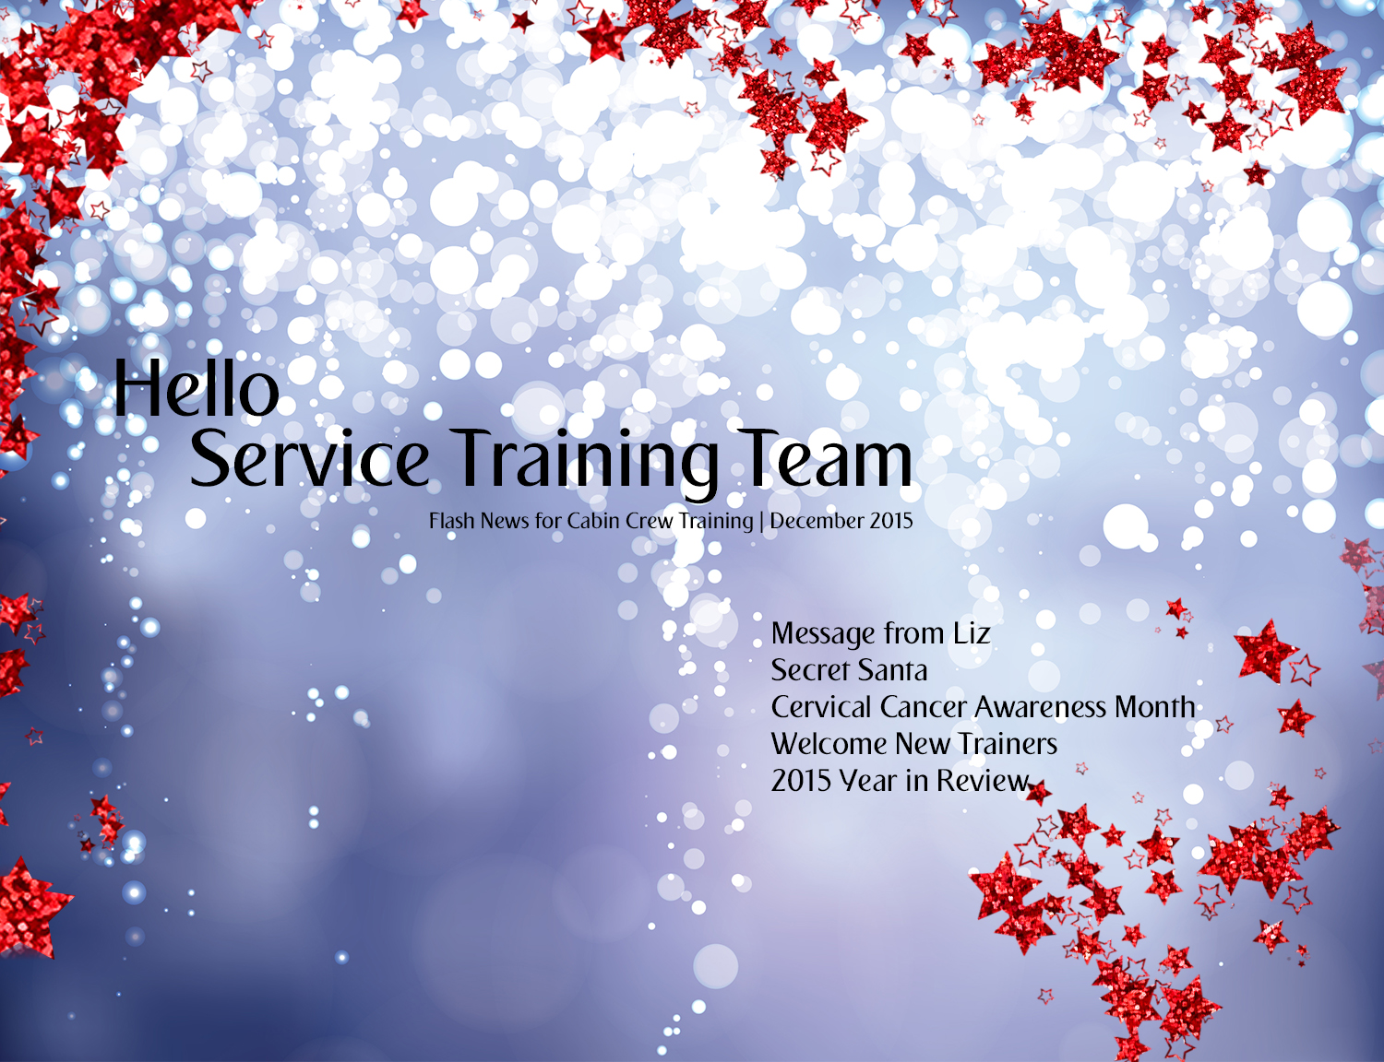

Click logo to go home

Slide 2

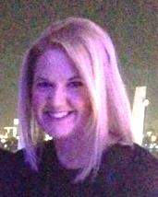

To our dear Service Training team, a huge thank you for another superb and successful year.
I hope you will enjoy this month’s edition of our Flash News.
I look forward to an exciting and busy 2016 with many opportunities coming our way….
I look forward to hearing about your New Year’s Resolutions and sharing some of mine ☺
Keep safe, healthy and happy as always.
A very Happy New Year to you all.
Best wishes,
Liz

Slide 3


Slide 4
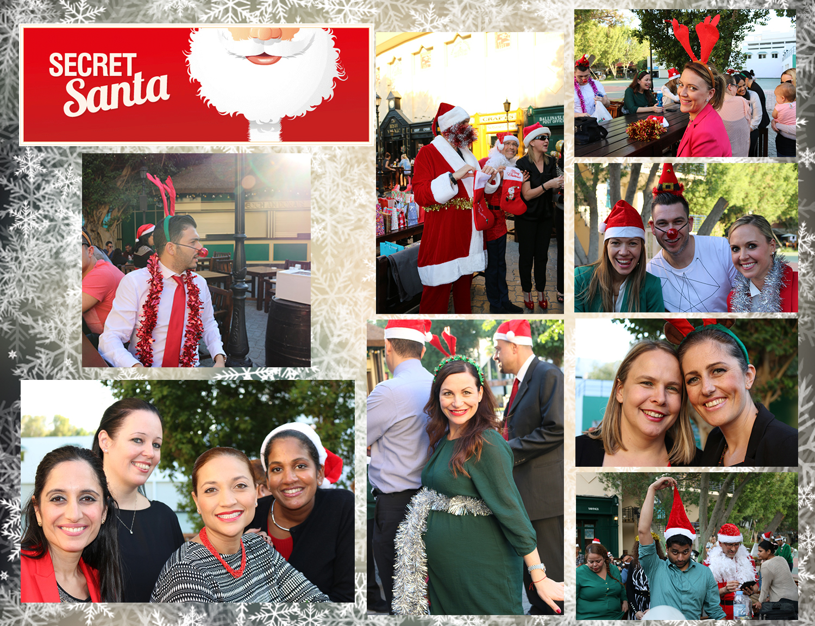

Slide 5
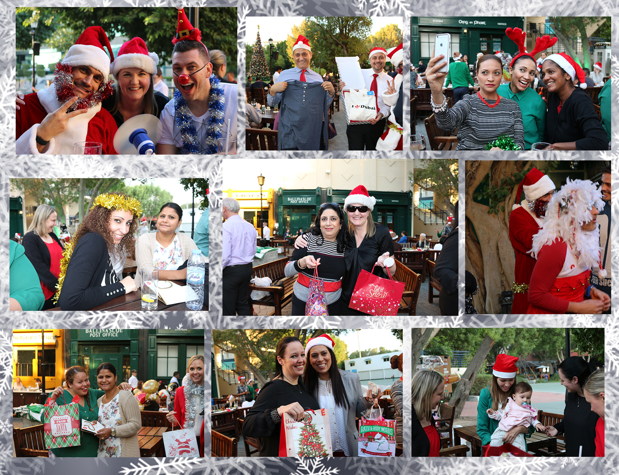

Slide 6
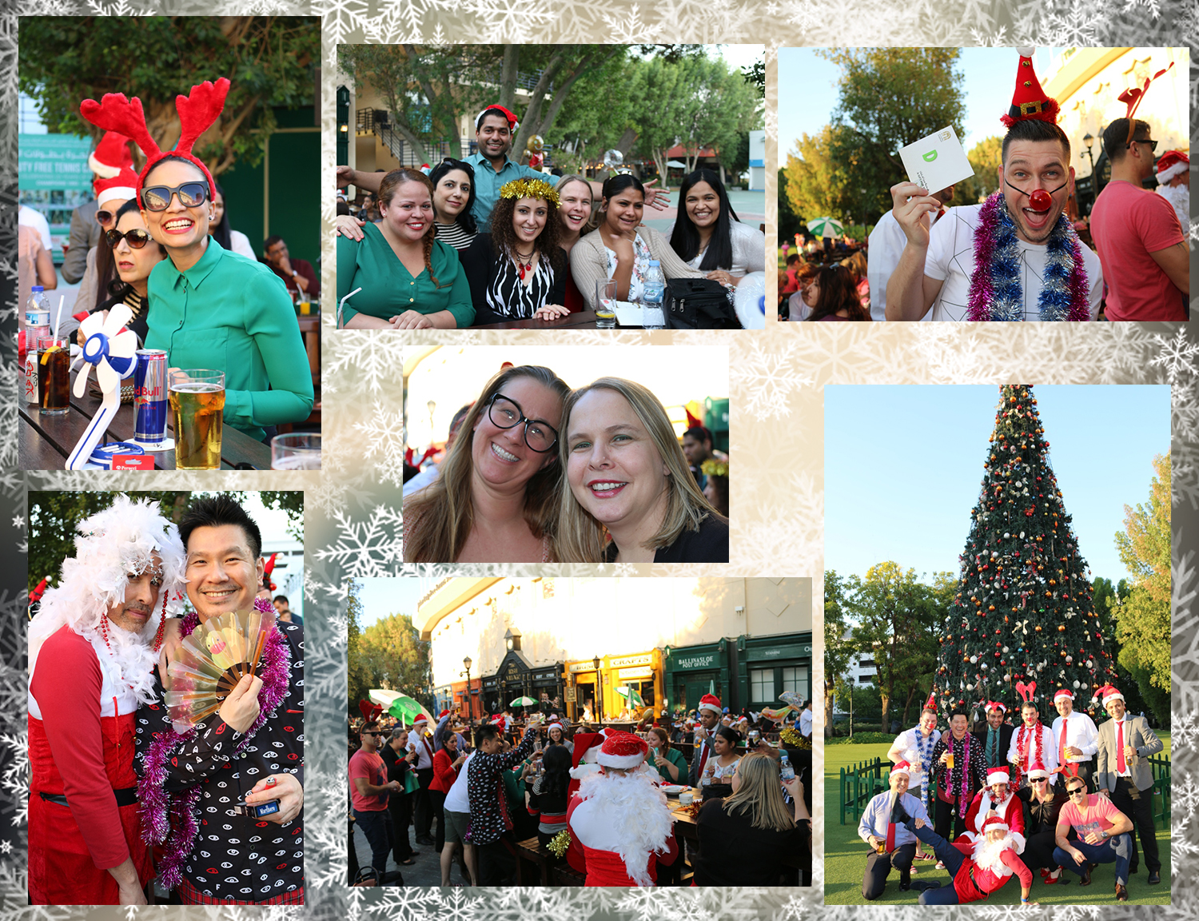

Slide 7
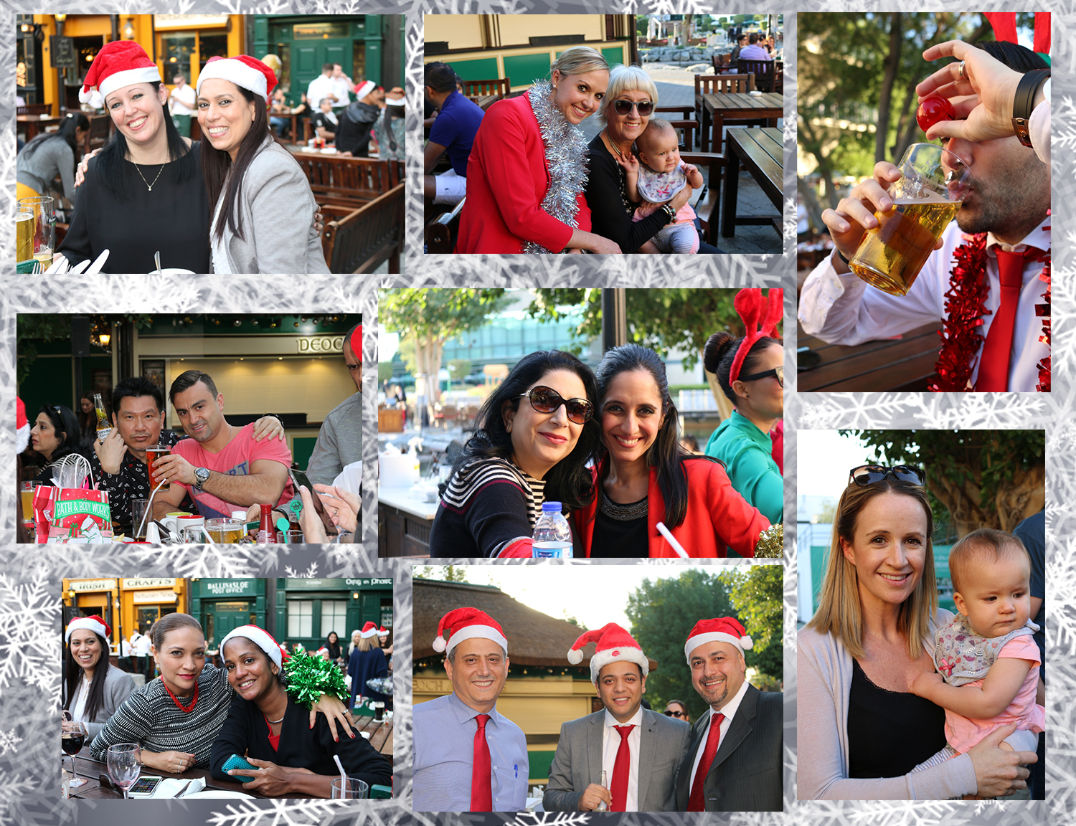

Slide 8

News | Cervical Cancer Awareness Month
This time last year I wasn't dreaming of finding new shoes or the latest hand bag under the tree, instead, I was hoping for one wish to come true and be Cancer free for Christmas.
I have decided to share my experience now in particular because once the festive cheer is over and the celebrations of welcoming 2016 have finally wound down, January will not only mark the beginning of an exciting new year ahead, it is also Cervical Cancer Awareness Month.
My story began in July 2014. I had began to experience a unique set of symptoms which were very typical of Cervical Cancer. After a series of tests and investigation I was given the devastating news that I did indeed have Cancer of the Cervix, stage 1B1.
I was very lucky that mine was classed as early stage but serious enough to require treatment that would not only save me but change my life forever.
I was fortunate to avoid the agony of Chemo and Radio Therapy but the operation would affect my fertility, which I found devastating.
On 5th December 2014 I spent five and a half hours in surgery to remove most of my cervix and fourteen of my pelvic lymph nodes. On 18th December 2014 my wish came true and I received the call to confirm that my operation was a success, I was cancer free for Christmas!
I am now in remission and have check-ups every few months for 5 years to follow my surgery... so far so good!!

Slide 9

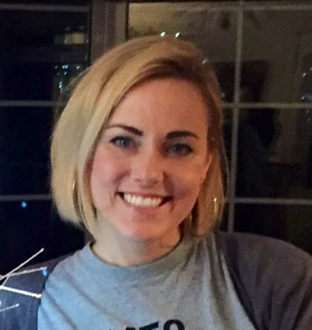
News | Cervical Cancer Awareness Month
I am grateful for what I see as my 'second chance' and have been heavily focused on raising awareness to Cervical Cancer in a bid to help others know the signs and take necessary preventative action to protect themselves and their families.
I appreciate that there are men reading so I have been careful not to go into too much detail about signs, symptoms, treatment and preventative measures (regular screening and vaccinations).
I have included the link to my Facebook page where you can access information to associated causes, signs and symptoms, cervical screening and vaccines to protect younger women. If you do wish to see my story in full detail I have made a video which is accessible on my Facebook page.
https://www.facebook.com/naomiormefightlikeagirl/
I would like to wish my fabulous training family a fantastic festive season. It has been amazing to have had the support from everyone, especially when I returned to the office in January, this year. My recovery has been, and continues to be, so much easier with the great people I have around me. Naomi Orme

Slide 10
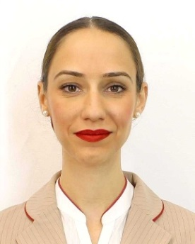
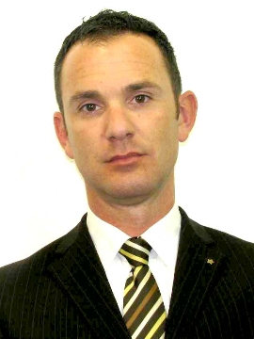
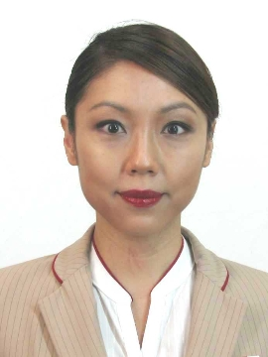
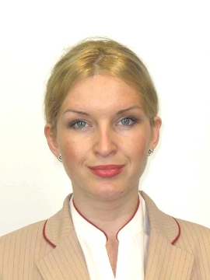
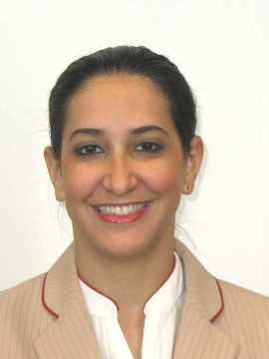
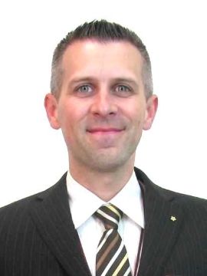
News | Welcome New Trainers
Please join us in welcoming our newest part-time trainers;
Congratulations and Welcome
Saskia
Pablo
Jenny
Tanja
Flavia
Louis

Slide 11


Slide 12
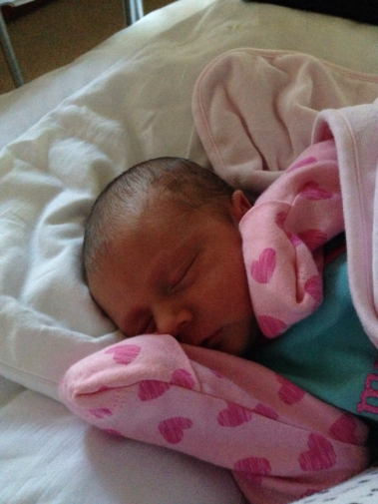
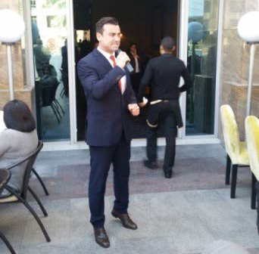
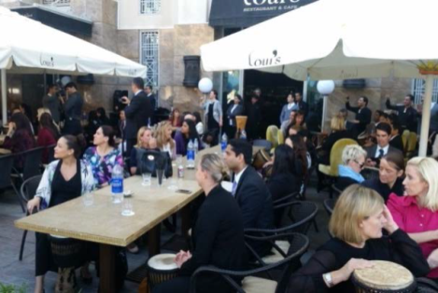
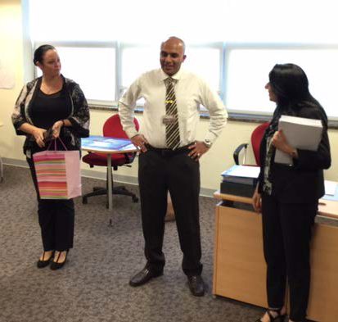
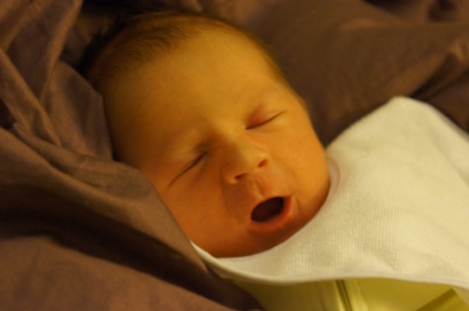
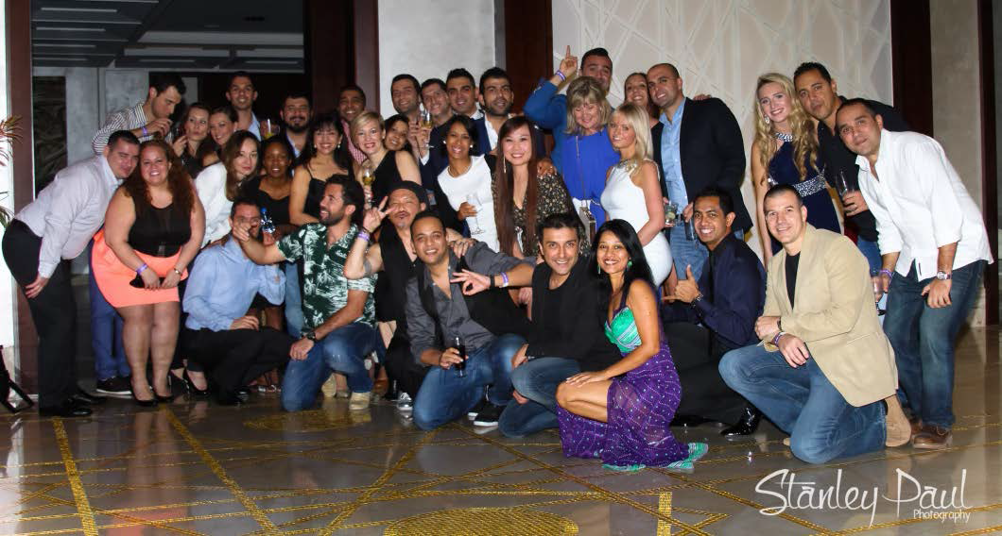
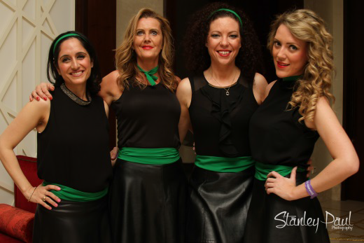
Highlights of January 2015
Farewell to PTT - Neil Gabriah
SD Forum - Hosted by Wassim
Congratulations to Sam Carre and her family, Martin and Luke, on the arrival of their newest family member Natalie.
Annual Service Delivery staff party
Congratulations to Shannon and Tommy on the arrival of their first born and most precious little person, Kaylee.

Slide 13
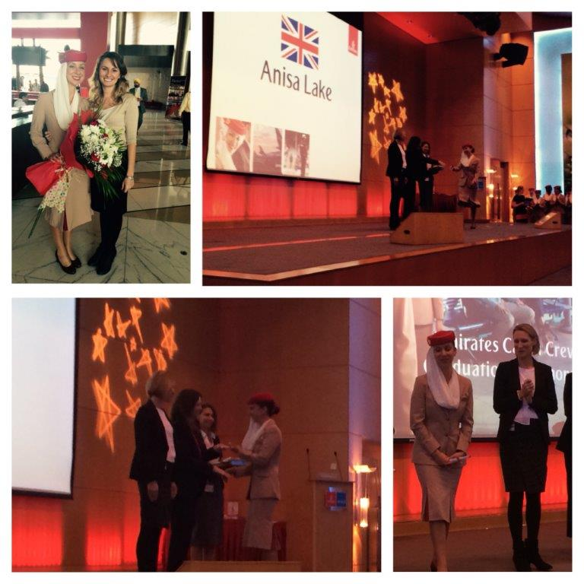
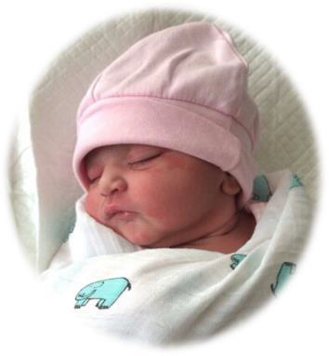
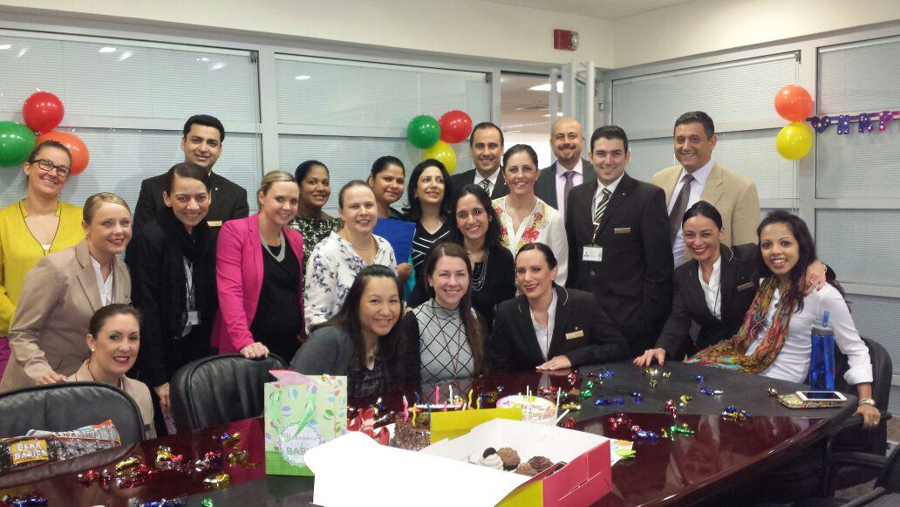
Highlights of February 2015
Congratulations to Neil and his wife on the birth of their beautiful daughter Ishani.
Congratulations to PTT Anisa Lake who successfully graduated as Cabin Supervisor on the line.
We offered our best wishes to PTT Sirichanya Kongslip (Katie) training before going on maternity leave.

Slide 14
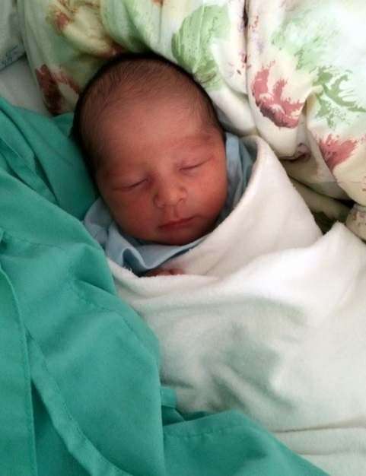
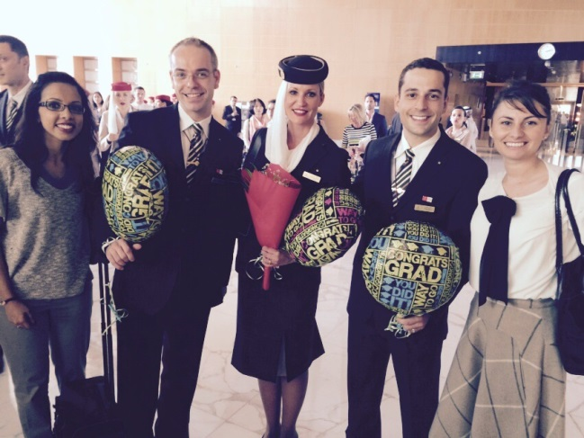
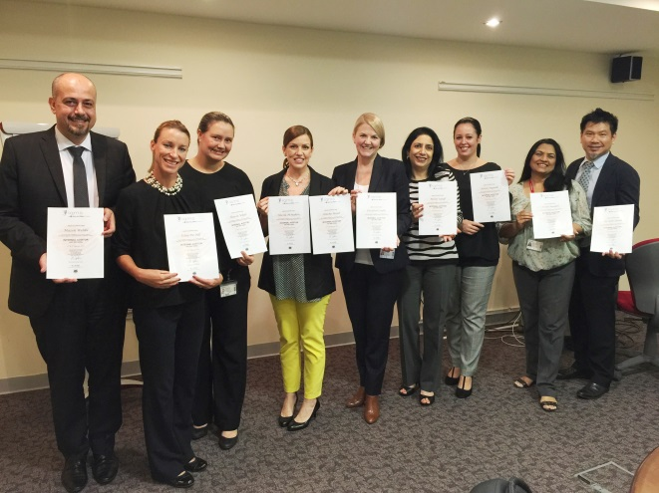
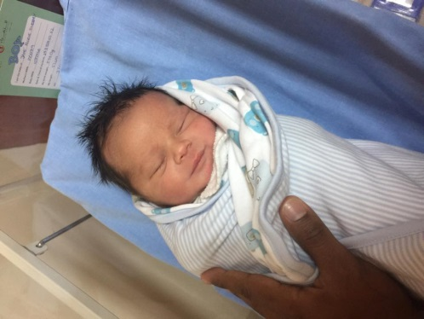
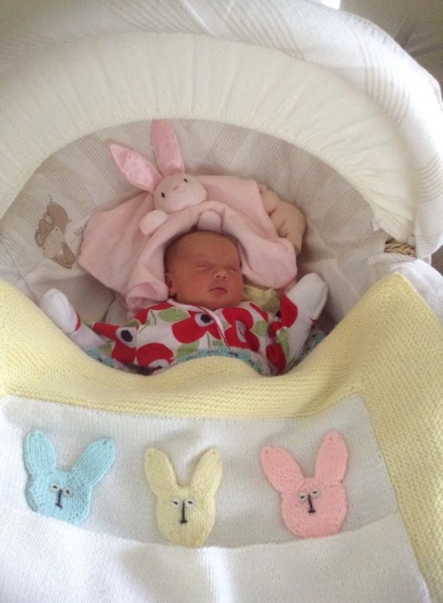
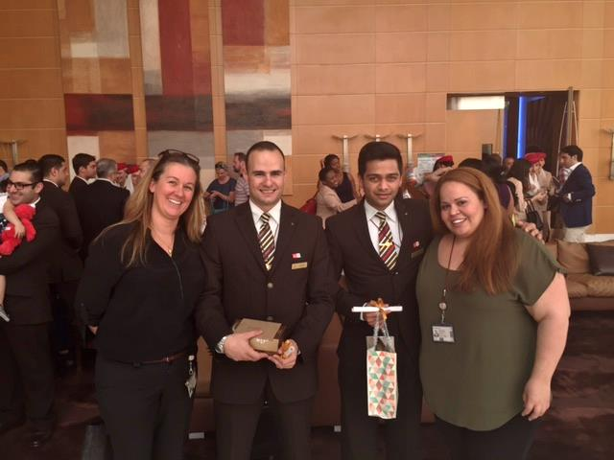
Highlights of March 2015
Kim, Sharon, Meher, Kiran, Mazen, Karen, Simone, Nicola, Islay and Liz successfully completed and passed the Audit course.
A huge congratulations to Sirichanya Kongsilp (Katie) and her family Tony and Ela on the safe arrival of their newest family member, Hugo.
Congratulations to Juliane Schreilechner, Andre Zabot , Juan Losa Stanger for graduating their Purser pool.
A big congratulations, Jane Pattinson and her husband Adam welcomed to the world their new little son Jack.
Congratulations to Kelly Hewitt and her family Mark and Tristan on the safe and happy arrival of their newest family member, Sienna Grace.
Congratulations to Giscard Matar and Jaycinth Noronha for graduating their Purser pool & Cabin Supervisor pool .

Slide 15
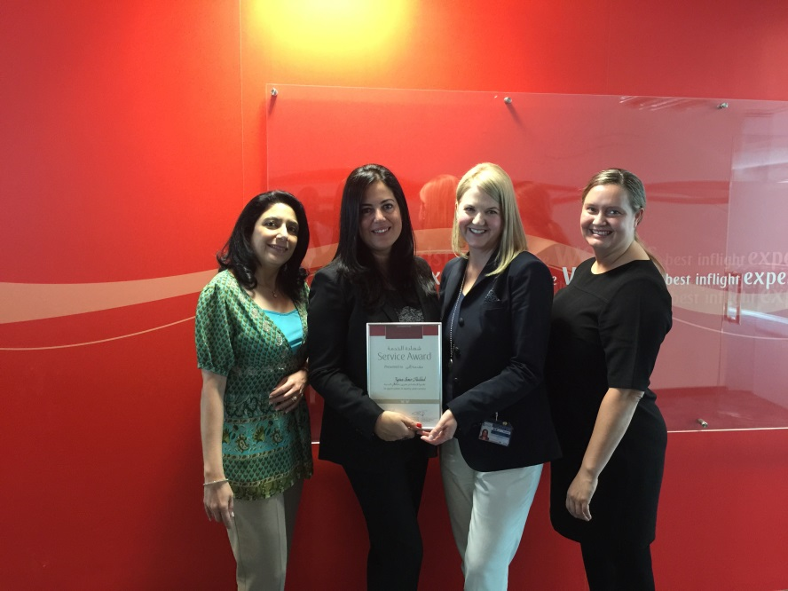
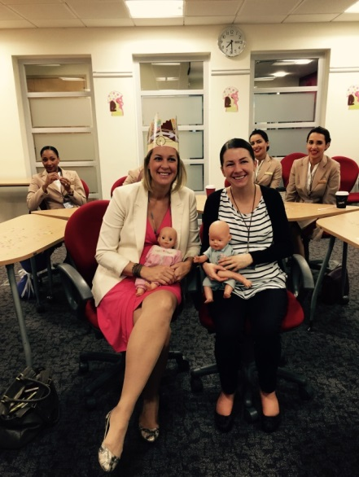
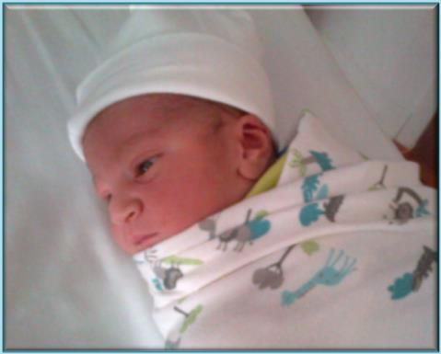
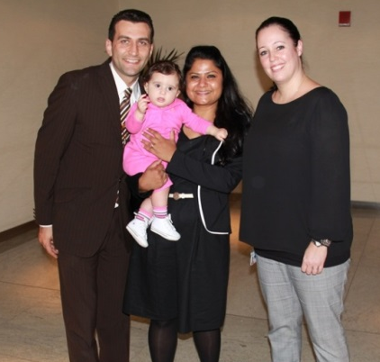
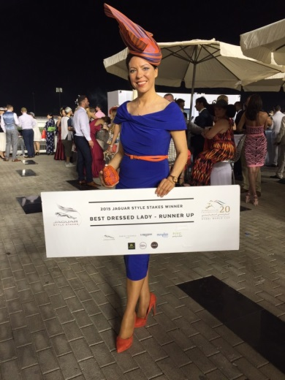
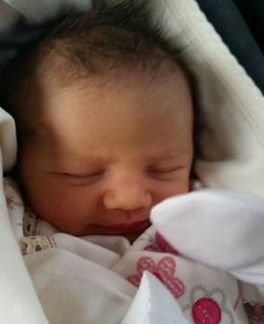
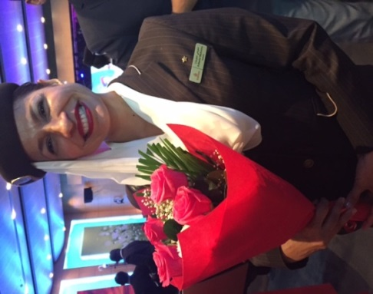
Highlights of April 2015
We are delighted to share that Sonia and Fabio are the proud parents of a beautiful baby boy named Diego Lombardi
Zeina celebrated her 20 years in Emirates Airlines
Jennie and Ela's last day in training before going on maternity leave.
Congratulations to Roland on graduating his Purser pool.
Congratulations to Ana and Dragan on the safe and happy arrival of their newest family member, Nina.
Congratulations to Ashwini for her Purser Graduation.
Evelyn won the ‘Best Dressed Lady – Runner up’.

Slide 16
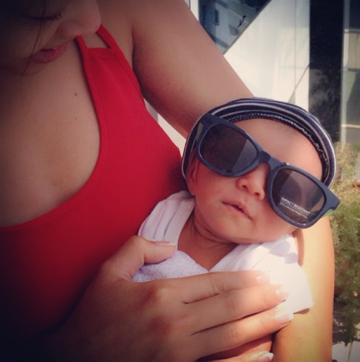
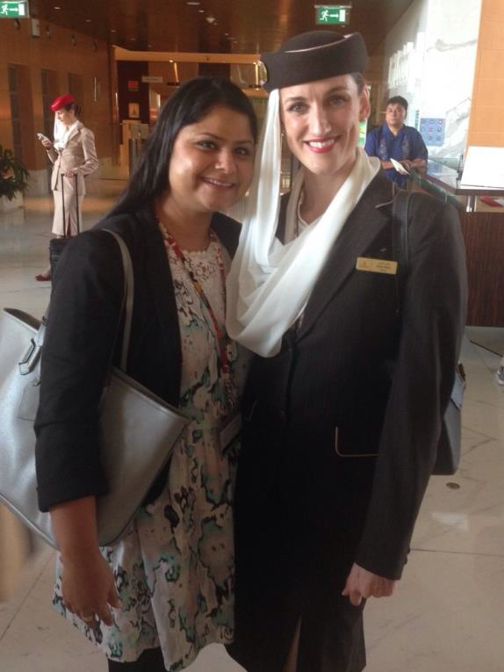
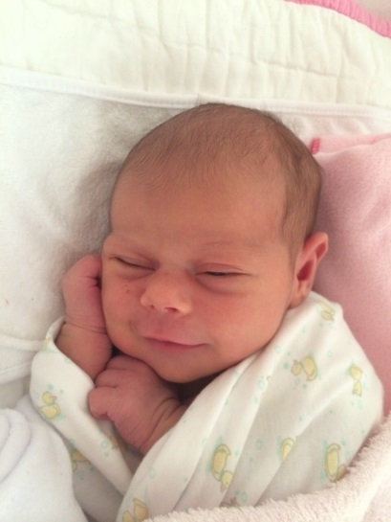
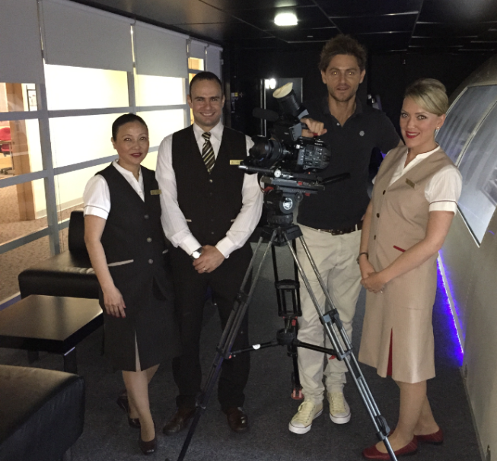
Highlights of May 2015
Rachel Soriano and Steven are now the proud parents of a Baby boy, Connor
Zaharina Butzova
Delivered her baby girl Matea
Omita, Zara and Giscard who were interviewed for the Wine documentary video
Congratulations to Katie Giddy for her Purser Graduation.

Slide 17
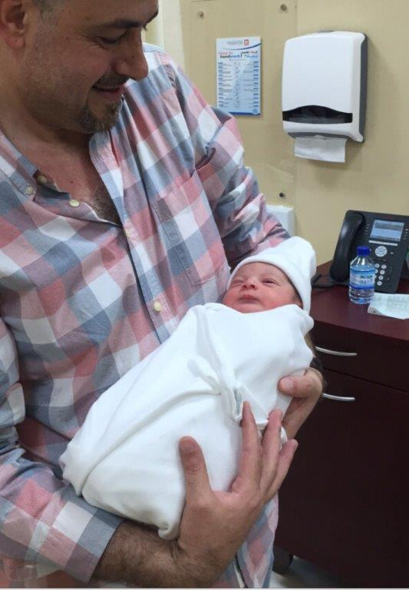
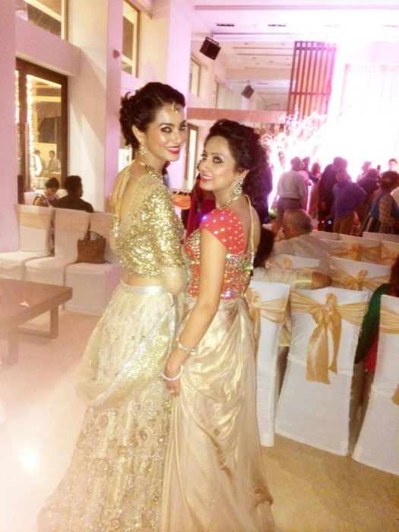
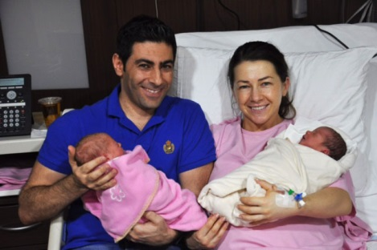
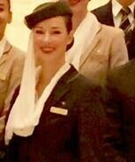
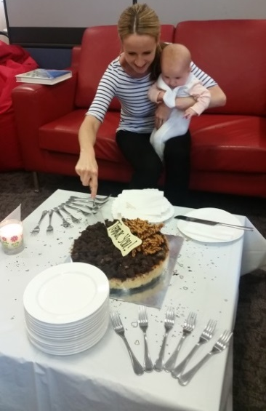
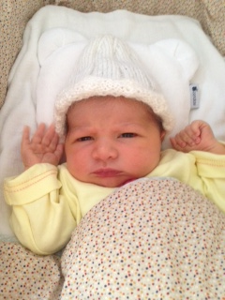
Highlights of June 2015
Congratulations to our stunning bride Kamaljit
Congratulations to Ela her husband Marwan on the arrival of their twin baby daughters
Kalina and Bianka
Congratulations to Mazen
our Youngest Grandpa
in the Service Training Team
Congratulations to Roxane Scott for her Purser Graduation.
Jennifer, Yannick & Oscar are delighted to announce the arrival of Lili Cayrol
Farewell to Shannon Orr

Slide 18
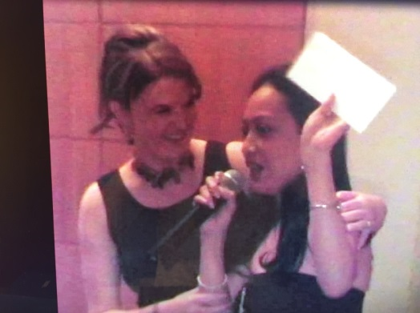
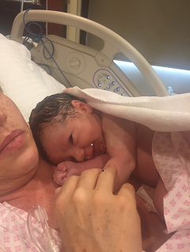
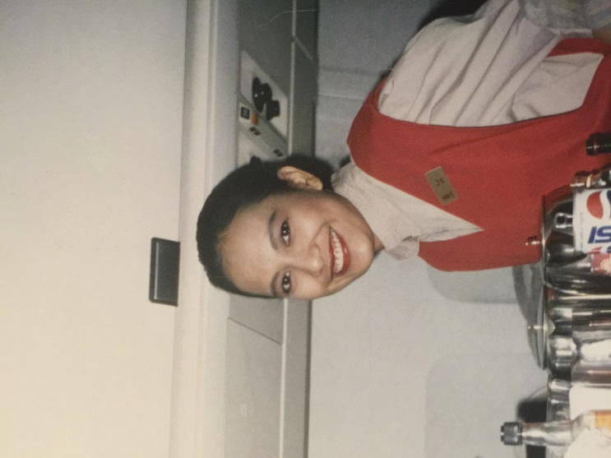
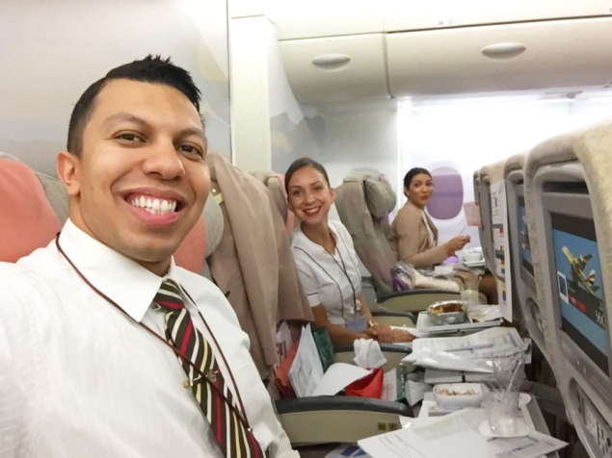
Highlights of July 2015
Our dearest friend and colleague Leila,
sadly passed away
Congratulations to
Nicola Mcmahon
Delivered her baby boy Lewis Christopher Sfeir
Farewell to Bruno Silva

Slide 19








Highlights of August 2015
Welcome our new Core Team members

Slide 20





Highlights of September 2015
Emirates Ab initio Programme.
Tomorrow’s Cabin Crew
Congratulations to Silvia and Jay on the birth of their
gorgeous baby boy Noah
Our 1st Webinar

Slide 21





Highlights of October 2015
We offered our best wishes to PTT Daniela before going on maternity leave.
We offered our best wishes and farewell to Ioana and Islay
Congratulations to Sylvester for her Purser Graduation.

Slide 22





Highlights of November 2015
‘” Your professionalism and dedication for the financial year 14/15, with over 245,000 training days delivered across Cabin Crew Training it has been a very busy year. We are always impressed by the energy of the training environment and we know this is down to each and every one of you. Your passion and commitment to your role is valued and really does make a difference. Thank you.”
We wished Romina farewell before she goes on her maternity leave.
A huge congratulations to Ghina & Wassim on the safe arrival of their newest family member, Majd.
Jen visited college recently with her 4 month old daughter. Although sad to be leaving her Training family.
Congratulations to Jodie and Ehab.

Slide 23




Highlights of December 2015
Service Training celebrated 44th UAE National Day .
A huge congratulations to Jailyss who has been successful in the recent selection process for
Cabin Crew Manager!
We wished Samantha Carre farewell and all the best in her new role.

Slide 24


